Slide 1
Zillow/AirBnB and Noise Complaints

Slide 2
Dataset sources
https://www.kaggle.com/zillow/zecon
https://data.cityofchicago.org/Environment-Sustainable-Development/Noise-Complaints-in-Chicago/6ttz-f3sv/data
http://insideairbnb.com/get-the-data.html

Slide 3
Extract
Original data formats
Zillow | AirBnB | Noise-complaints
CSV | CSV | CSV

Slide 4
Transformations

Slide 5
Zillow ZIP code data transformation
Reduced data frame to applicable columns
Filtered data to last five years
Filtered data to Chicago only ZIP codes
Dropped NaN rows
Grouped by ZIP code and aggregated by mean of house prices

Slide 6
noise complaint TRANSFORMATION
Delete extra columns
Rename column
Add columns & calculate values
Select recent years
Get ZIP codes
Group data & aggregate to ZIP codes
Fix missing data and typos
Convert ZIP codes to string
Add 0 complaint ZIP codes

Slide 7
airBNB DATA TRANSFORMATION
Drop columns not required
Add new columns and calculate their values.
Drop columns no longer required.
Get zip code
Drop columns no longer needed.
Delete missing data and typos.
Group data by zip code and get count of airbnbs in area and average price per night

Slide 8
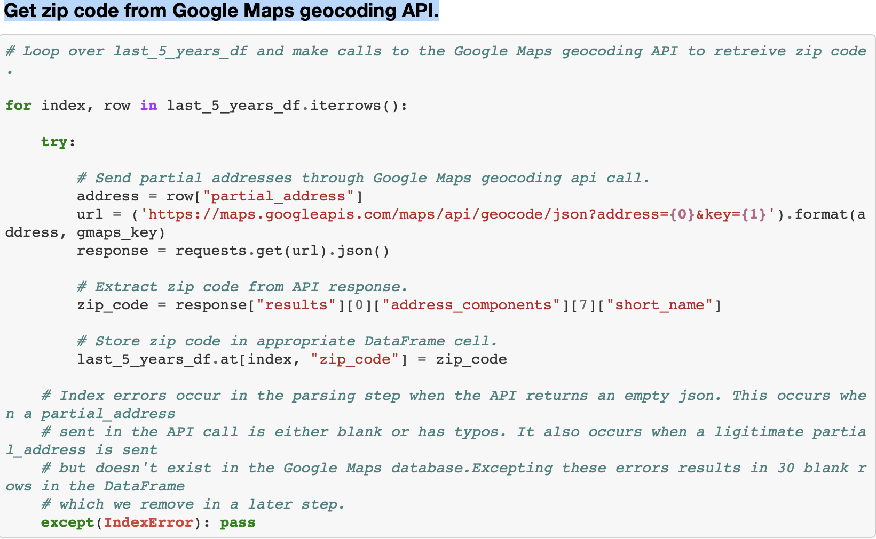
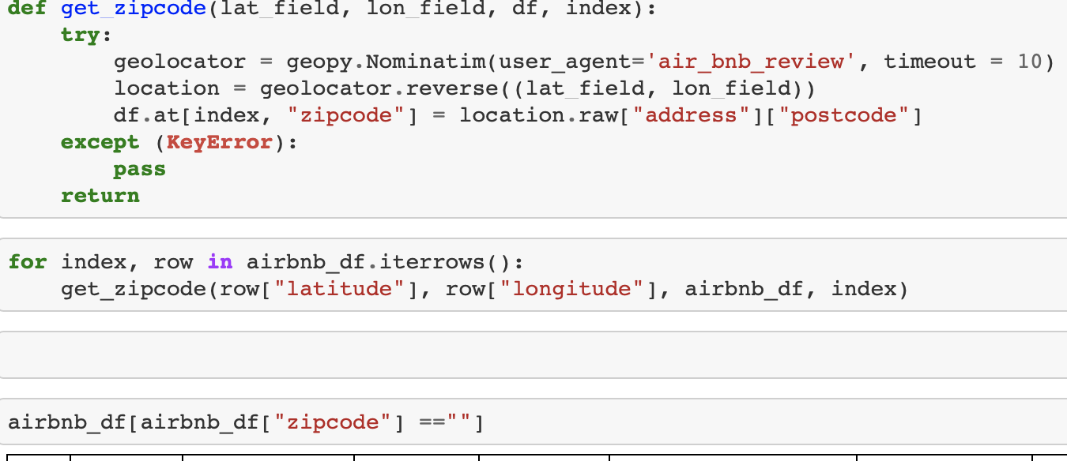
Two Ways to find ZIP CODES
AirBnB data
Noise complaint data
Using Geopy
Using Google Maps geocoding API

Slide 9
Load
Zillow data
AirBnB data
Noise Complaint
Postgres

Slide 10
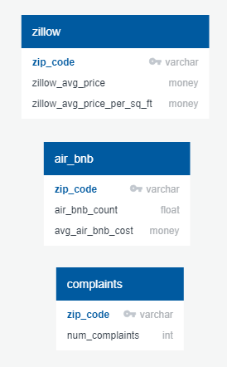
erd

Slide 11
SQL TABLE SCHEMA
CREATE TABLE air_bnb(
zip_code varchar PRIMARY KEY,
air_bnb_count float,
avg_air_bnb_cost money
);
CREATE TABLE zillow(
zip_code varchar PRIMARY KEY,
zillow_avg_price_per_sq_ft money,
zillow_avg_price money
);
CREATE TABLE complaints (
zip_code varchar PRIMARY KEY,
num_complaints int
);

Slide 12
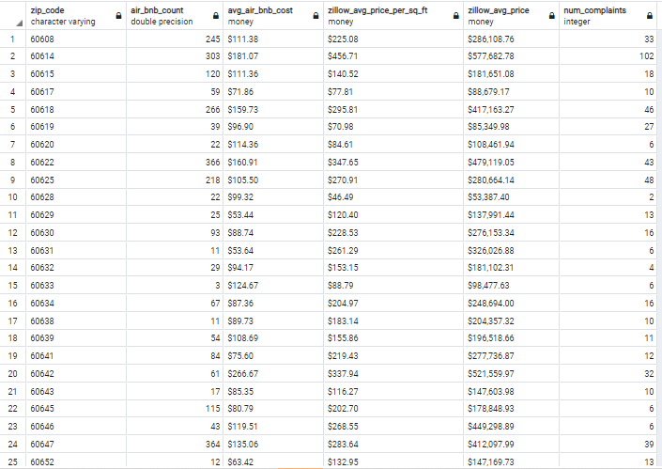
SQL QUERY
SELECT a.zip_code, a.air_bnb_count, a.avg_air_bnb_cost, z.zillow_avg_price_per_sq_ft, z.zillow_avg_price, c.num_complaints
FROM air_bnb a
INNER JOIN zillow z
ON a.zip_code = z.zip_code
INNER JOIN complaints c
on a.zip_code = c.zip_code;

Slide 13
potential QUESTIONS
What is the effect of noise complaints on property value in specific ZIP code?
Do ZIP codes with higher concentrations of AirBnB’s report more noise complaints?
What is the effect of property values in ZIP codes with high concentrations of AirBnB?
What is the effect of noise complaints on property values?

